Slide 1

Welcome to
CNN
By: Ahmed Haytham
2022-2023

Slide 2
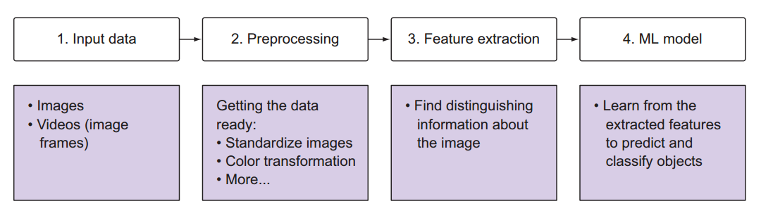
IMAGE CLASSIFICATION

Slide 3
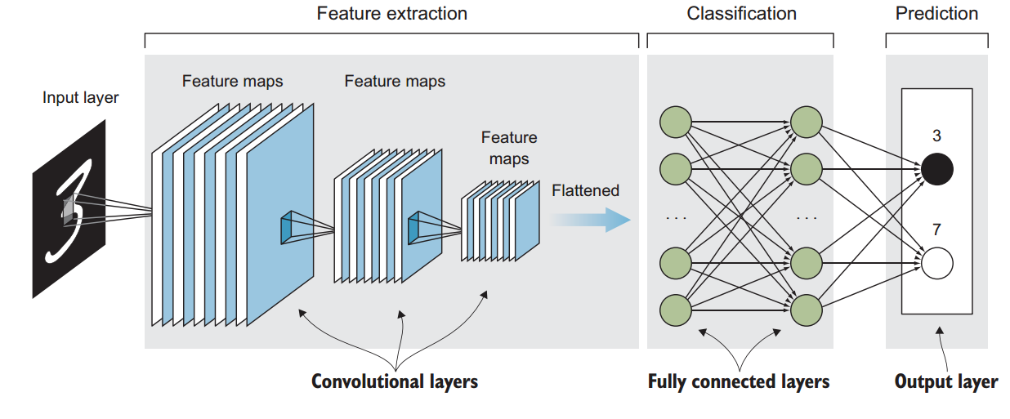
CNN ARCHITECTURE

Slide 4
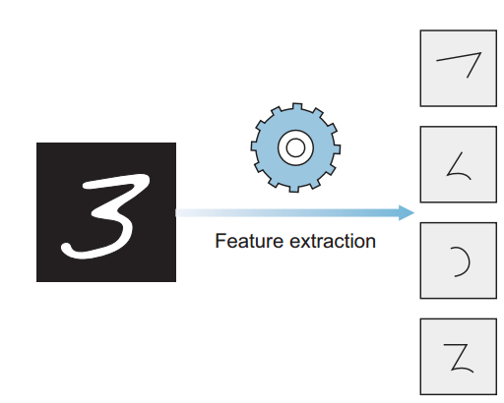
CLOSER LOOK AT FEATURE EXTRACTION & CLASSIFICATION
the feature-extraction step as breaking large images into smaller pieces of features and stacking them into a vector
Note that this is just a metaphor to help visualize the feature-extraction process. CNNs
don’t literally break an image into pieces

Slide 5
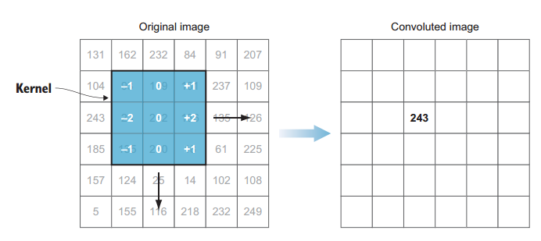
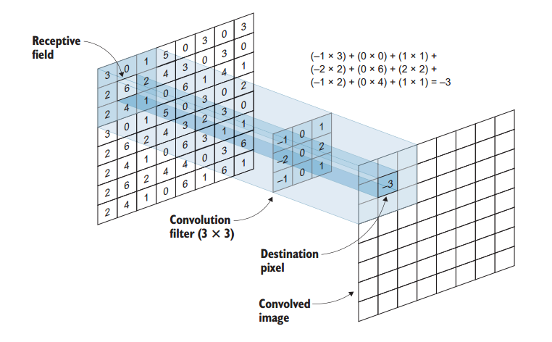
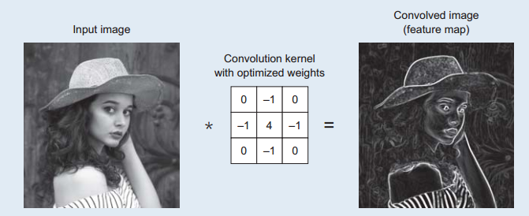
CONVOLUTIONAL LAYERS
A convolutional layer is the core building block of a convolutional neural network
In mathematics, convolution is the operation of two functions to produce a third modified function.

Slide 6
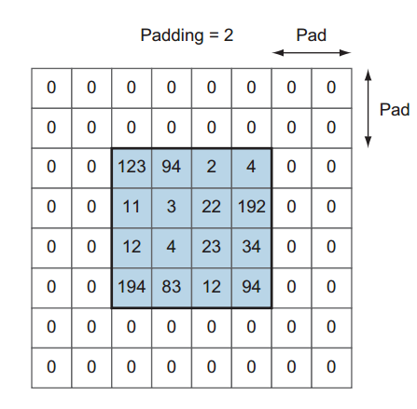
STRIDES AND PADDING
Strides—The amount by which the filter slides over the image. For example, to slide the convolution filter one pixel at a time
Padding—Often called zero-padding because we add zeros around the border of an image Save size of Image

Slide 7
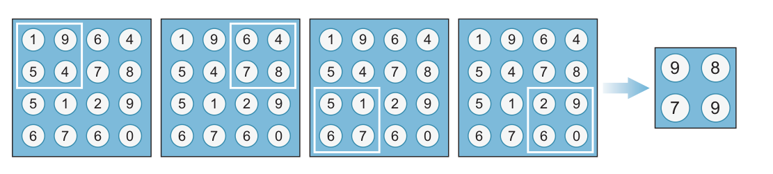
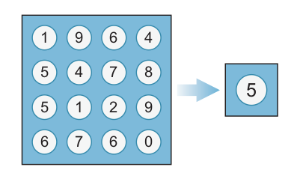
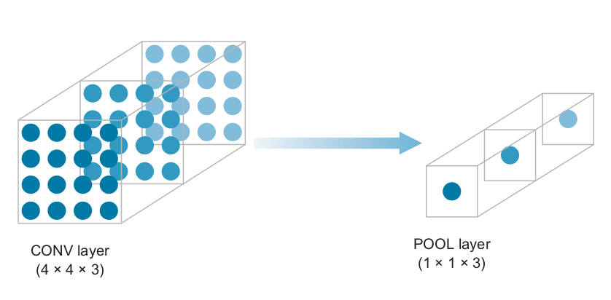
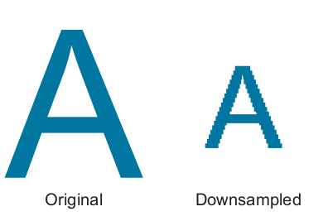
Pooling layers or subsampling
Adding more convolutional layers increases the depth of the output layer, which leads
to increasing the number of parameters that the network needs to optimize (learn).
You can see that adding several convolutional layers (usually tens or even hundreds)
will produce a huge number of parameters (weights)
MAX POOLING VS . AVERAGE POOLING

Slide 8
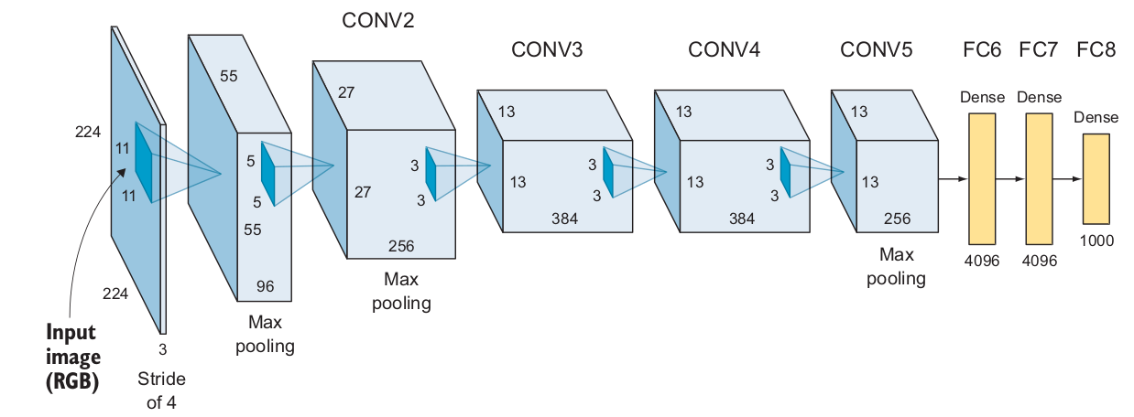

Slide 9
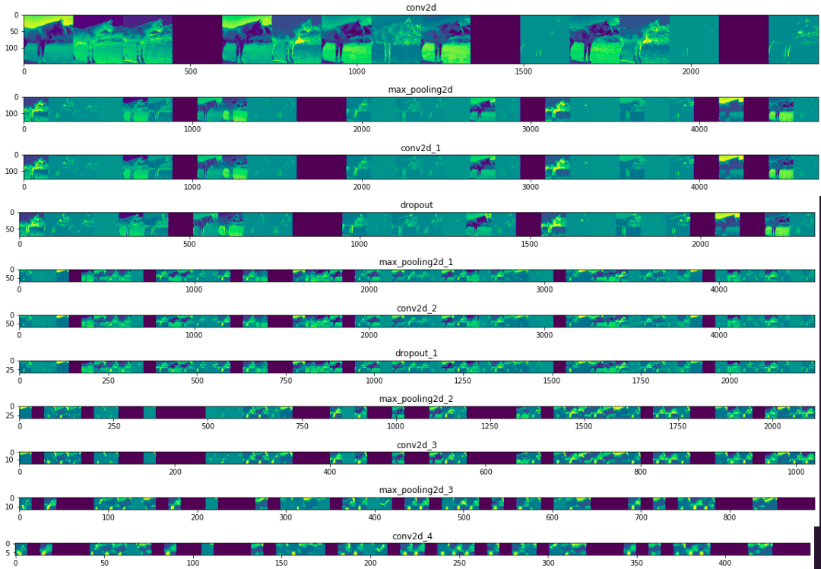

Slide 10
Thank you.
Very much!

